Slide 1

E-commerce Clothes Shopping Website
WARDROBE X
Patel Yash - 14
M.Sc. (CA) Part - 1
Under Guided by Dr. Rachna Shukla

Slide 2
GOAL
Offer Trendy Styles: Provide a wide range of fashionable clothing that keeps up with the latest trends.
Ensure Quality and Affordability: Balance high-quality materials with affordable prices for great value.
Deliver Exceptional Service: Make shopping easy with user-friendly navigation and excellent customer support.

Slide 3
TARGET AUDIENCE
Fashion-Conscious Shoppers: People who love staying up-to-date with the latest trends and styles.
Budget-Friendly Buyers: Customers looking for stylish, quality clothing at affordable prices.
Adults and couples: Our e-commerce clothing website serves fashion-conscious women, men, and couples seeking a diverse range of stylish options, from casual to formal attire, with a focus on personalized shopping experiences.

Slide 4
Software Requirement
Frontend:
React.js – For building dynamic and responsive user interfaces.
HTML, TailwindCSS, JavaScript – Core web technologies for structure and styling.
Backend:
Node.js – Server-side runtime environment.
Express.js – Web framework for building APIs and handling requests.
Database:
MongoDB – NoSQL database to store users, courses, lessons, and results.

Slide 5
Hardware Requirement
Processor: Intel i5
RAM: 4 GB (Client), 8 GB (Server)
Storage: 100 GB (Client), 256 GB SSD (Server)
Internet: Stable high-speed connection
Display: 1024x768 or higher

Slide 6
Admin Module:
Manage accounts and permissions.
Manage Categories
Add,Update,Delete Product
View and process orders
User Module:
View and search products
Add or remove products,view totals in cart
View order history

Slide 7
DATA FLOW DIAGRAM

Slide 8
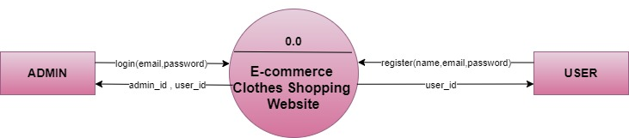
0(CONTEXT) LEVEL

Slide 9
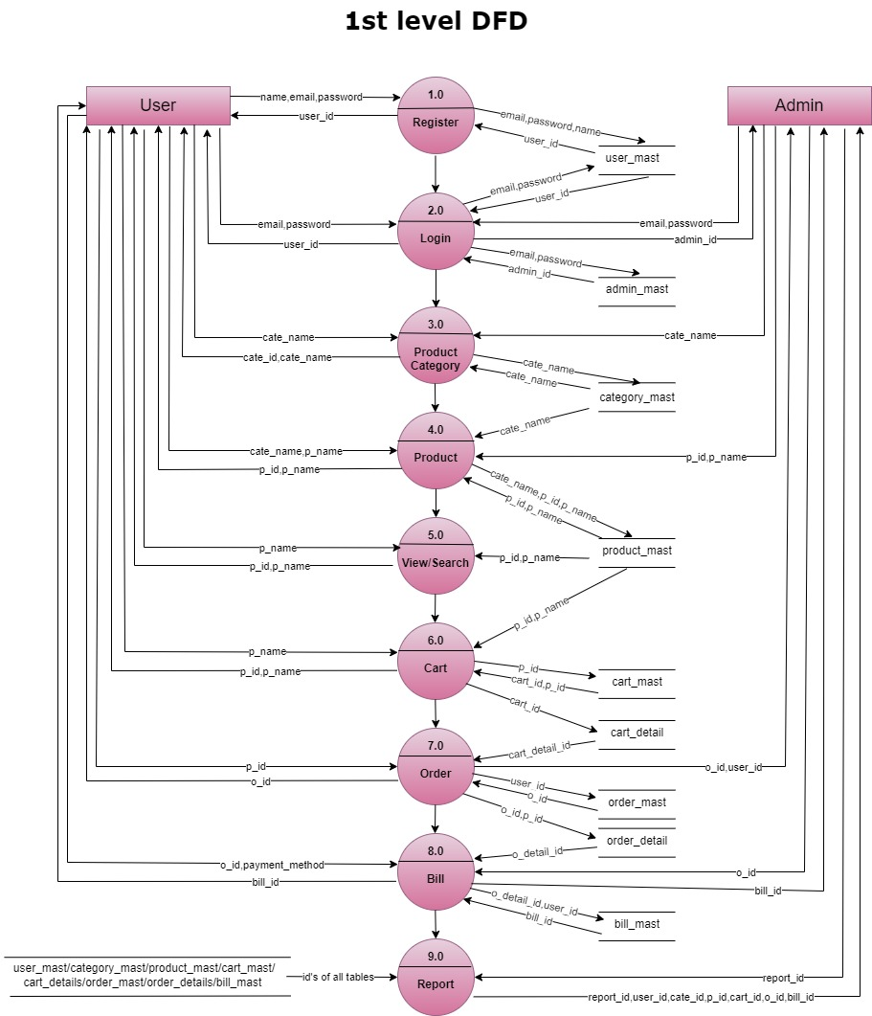
1ST LEVEL

Slide 10
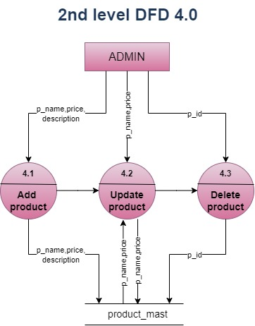
2ND LEVEL 4.0

Slide 11
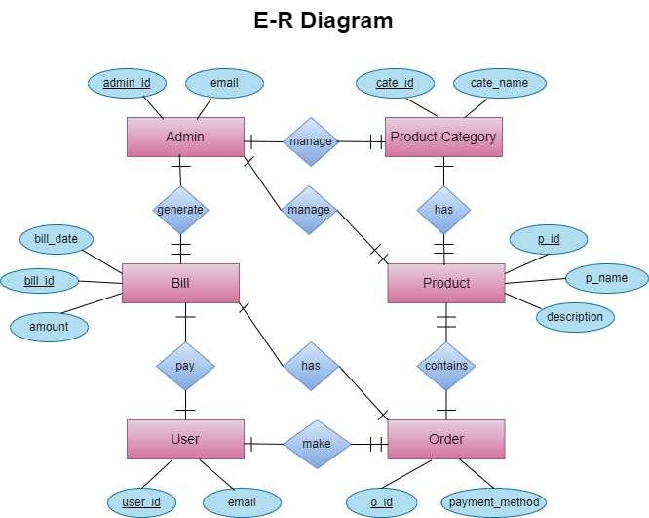
E-R DIAGRAM

Slide 12
admin_mast
Name | Type | Null | Key
admin_id | String | No | Primary key
name | String | No
email | String | No | Unique
password | String | No
Role | String | No | Defualt: admin

Slide 13
users
Field | Type | Null | Key
_id | String | No | Primary
name | String | No
email | String | No | Unique
phone | String | No
password | String | No

Slide 14
category_mast
Field | Type | Null | Key
cate_id | String | No | Primary
catename | String | No

Slide 15
product_mast
Name | Type | Null | Key
p_id | String | No | Primary
p_name | String | No | -
description | String | No | -
details | String | No | -
price | String | No | -
img | String | No | --
stock | String | No

Slide 16
cart_mast
Field Name | Type | Null | Key
cart_id | String | Null
user_id | String | No | (user_id) References user_mast (user_id)
created_at | timestamp | No | current_timestamp()

Slide 17
Order Details:
Name | Type | Null | Key
Order_id | String | No | Primary
CustomerName | String | No | -
email | String | No | -
phone | String | No | -
address | String | No | -
city | String | No | -
zip | String | No | -
state | String | No | -
PaymentMethod | String | No | -
Status | String | No | -
TotalAmount | String | No | -

Slide 18
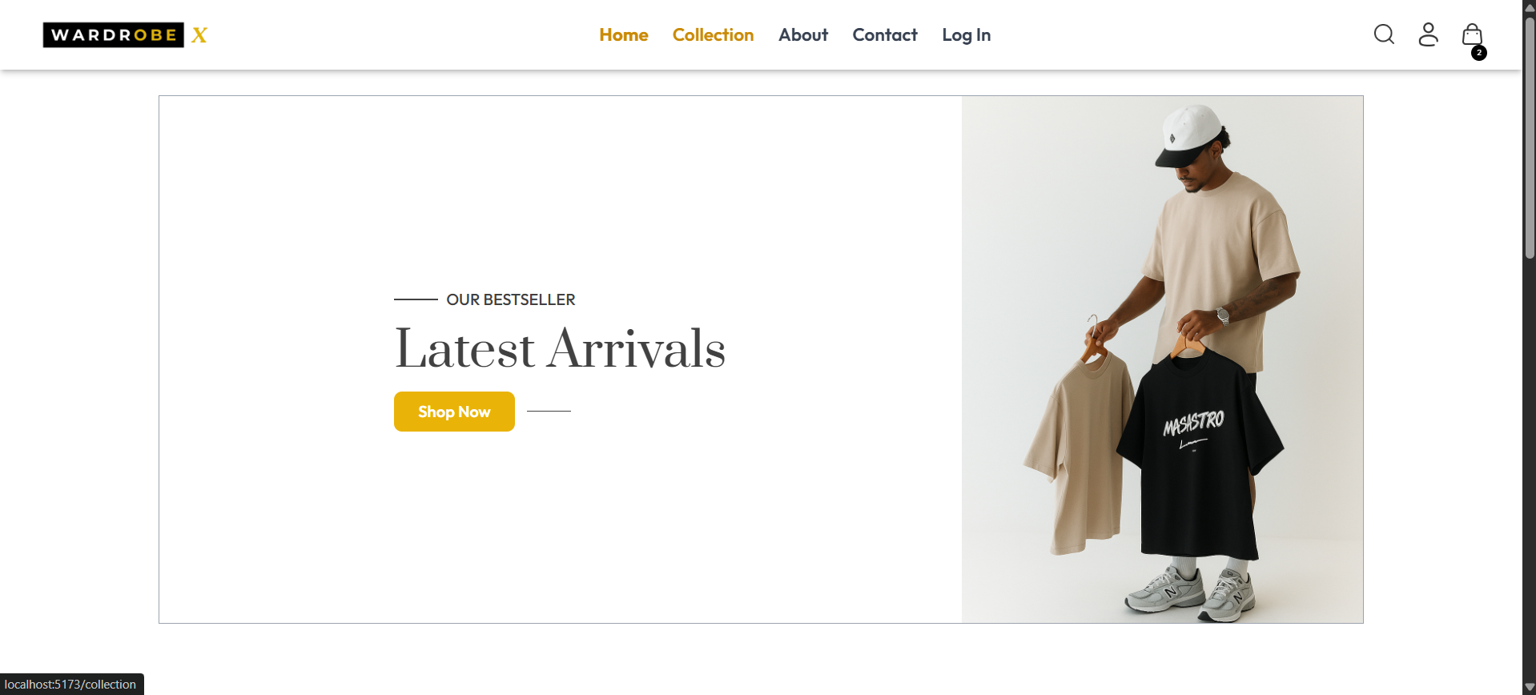
User Side :

Slide 19
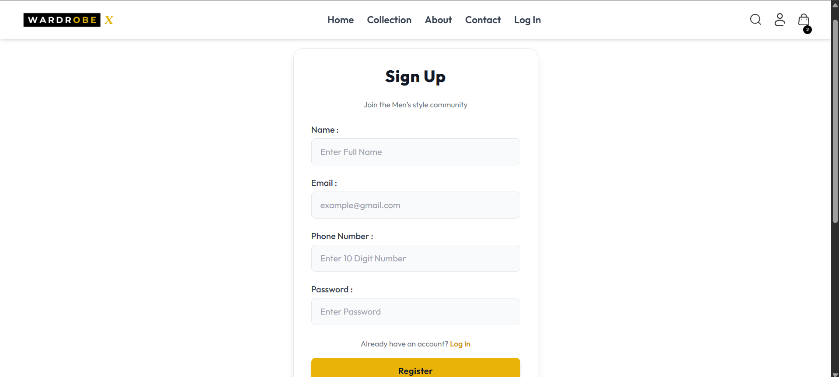
Registration Page :

Slide 20
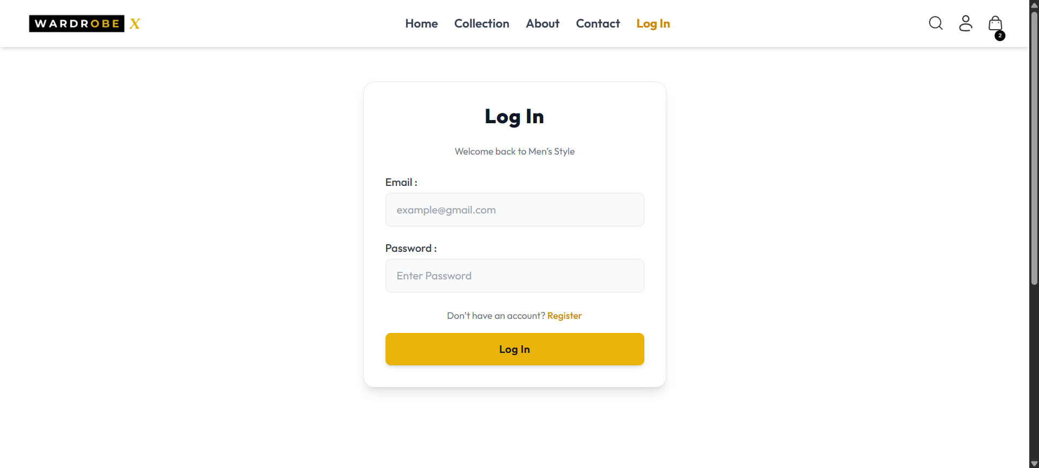
Log In Page :

Slide 21
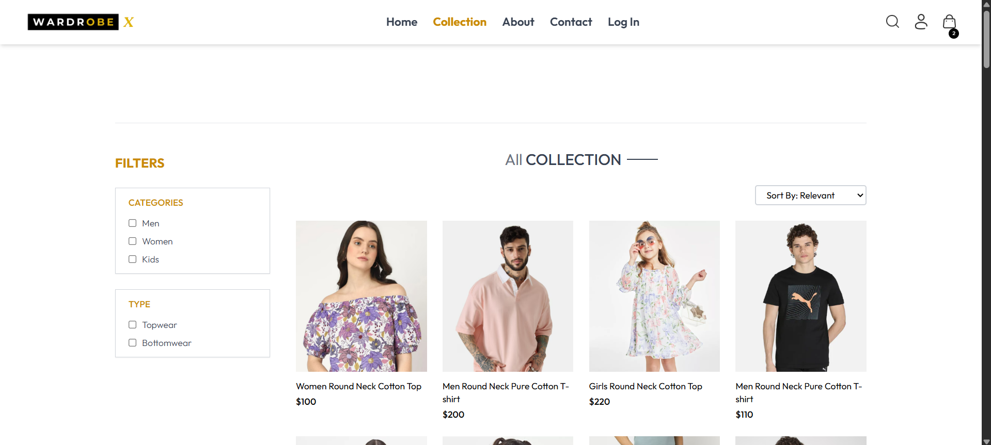
Collection Page :

Slide 22
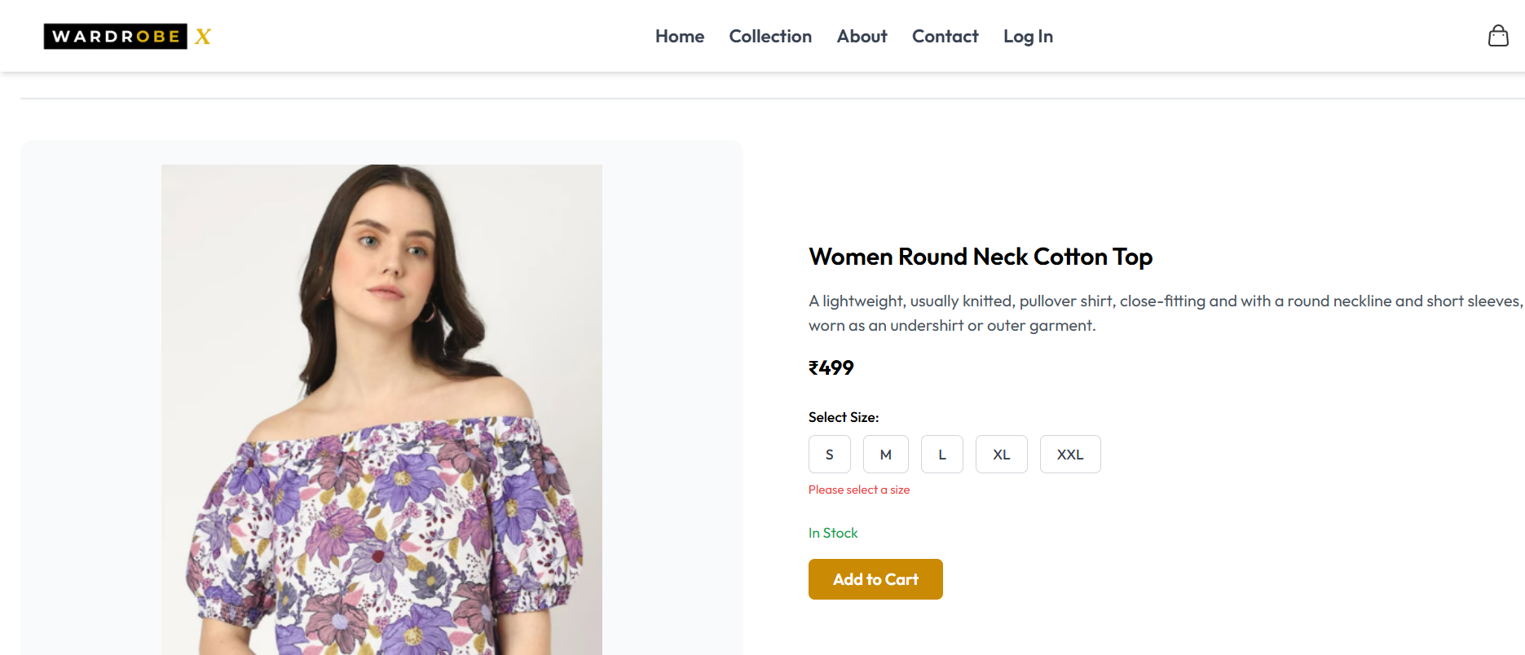
Product Page :

Slide 23
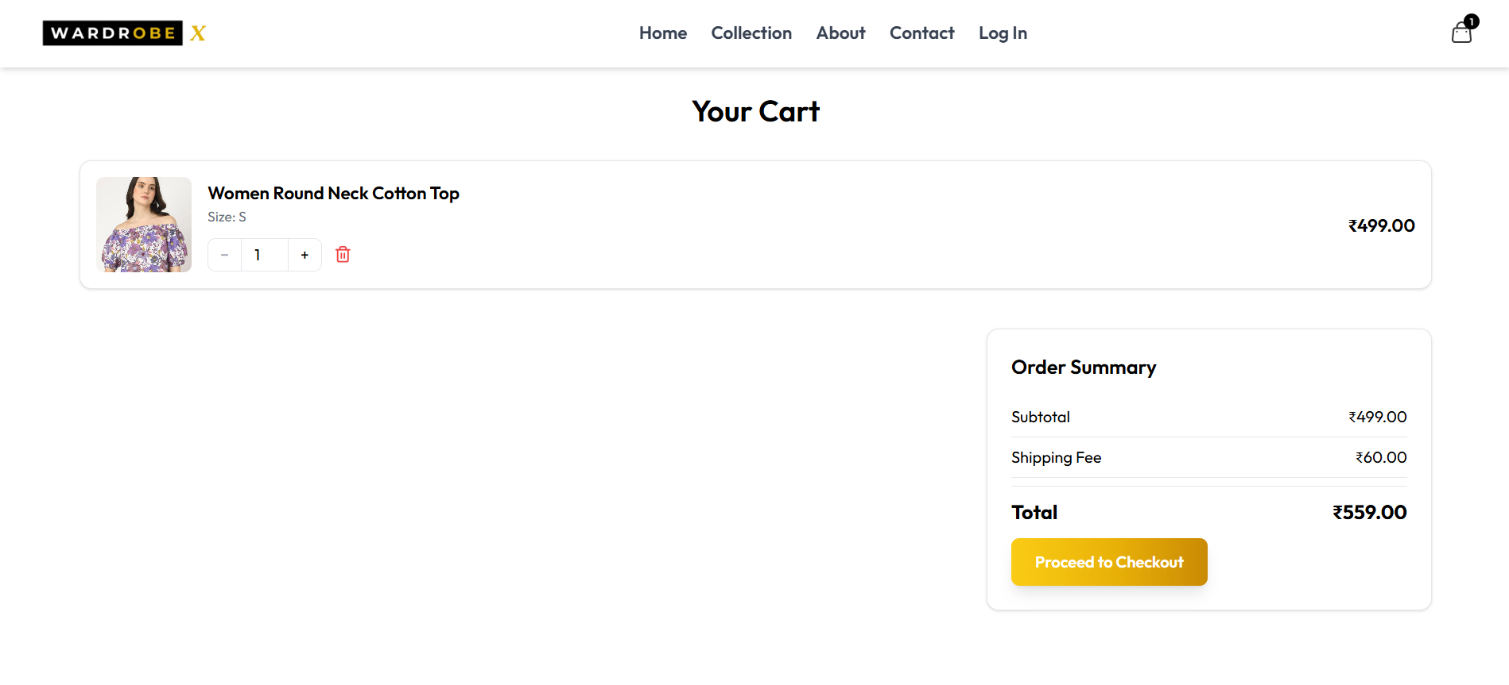
Cart Page :

Slide 24
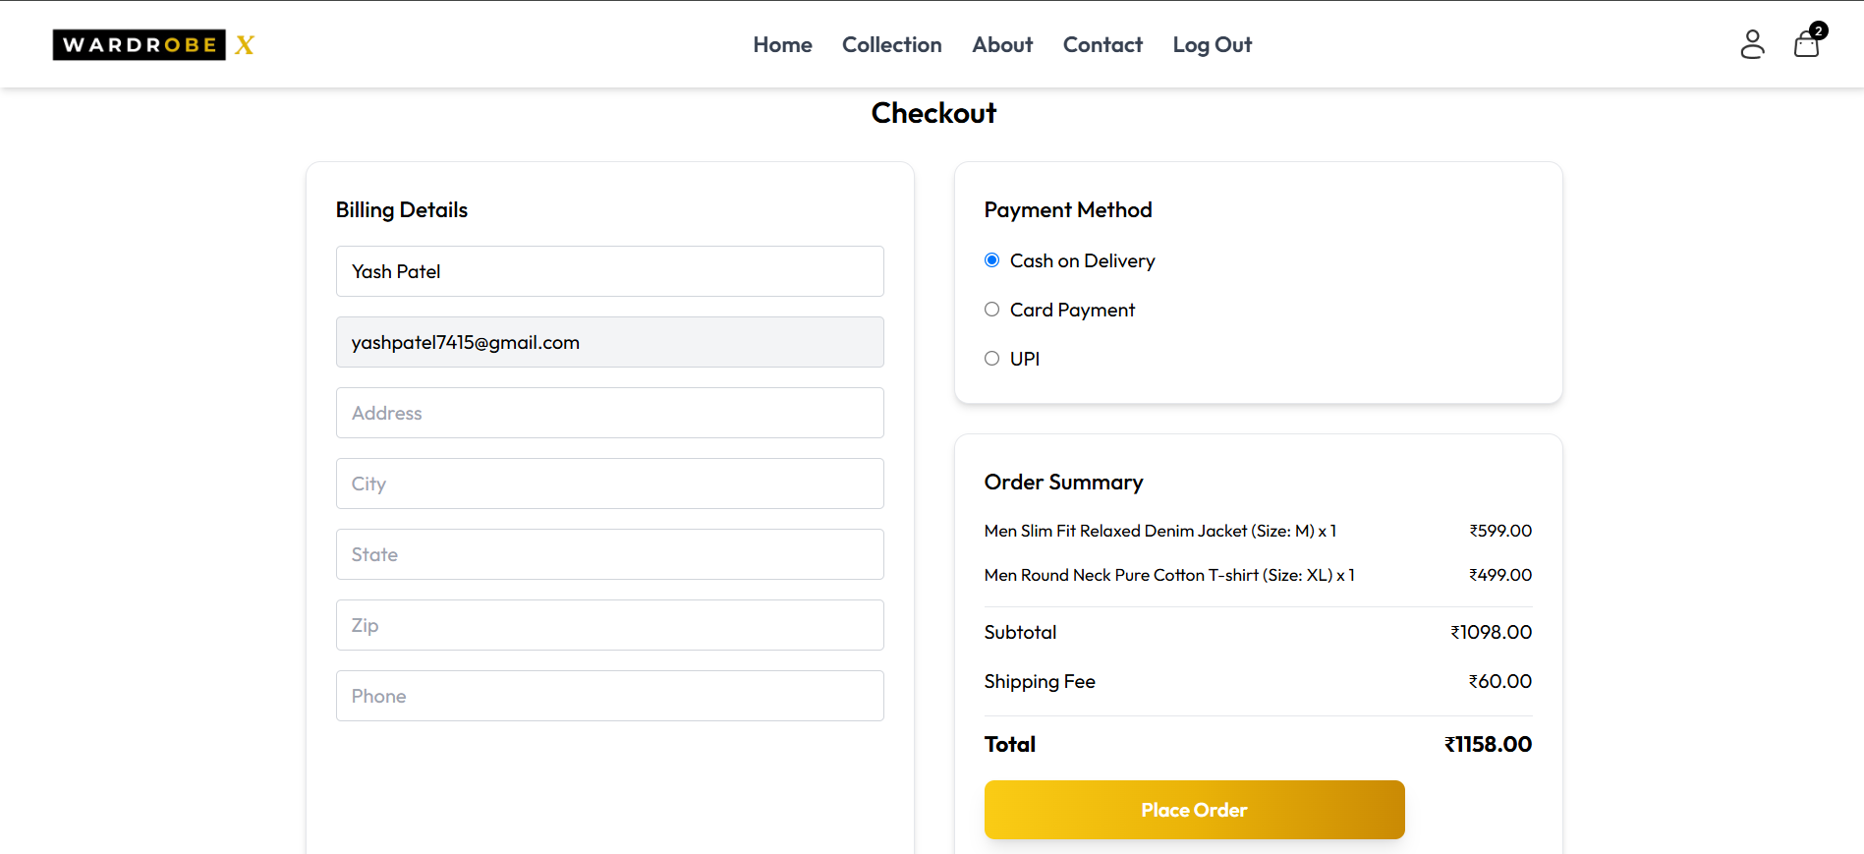
Place Order :

Slide 25
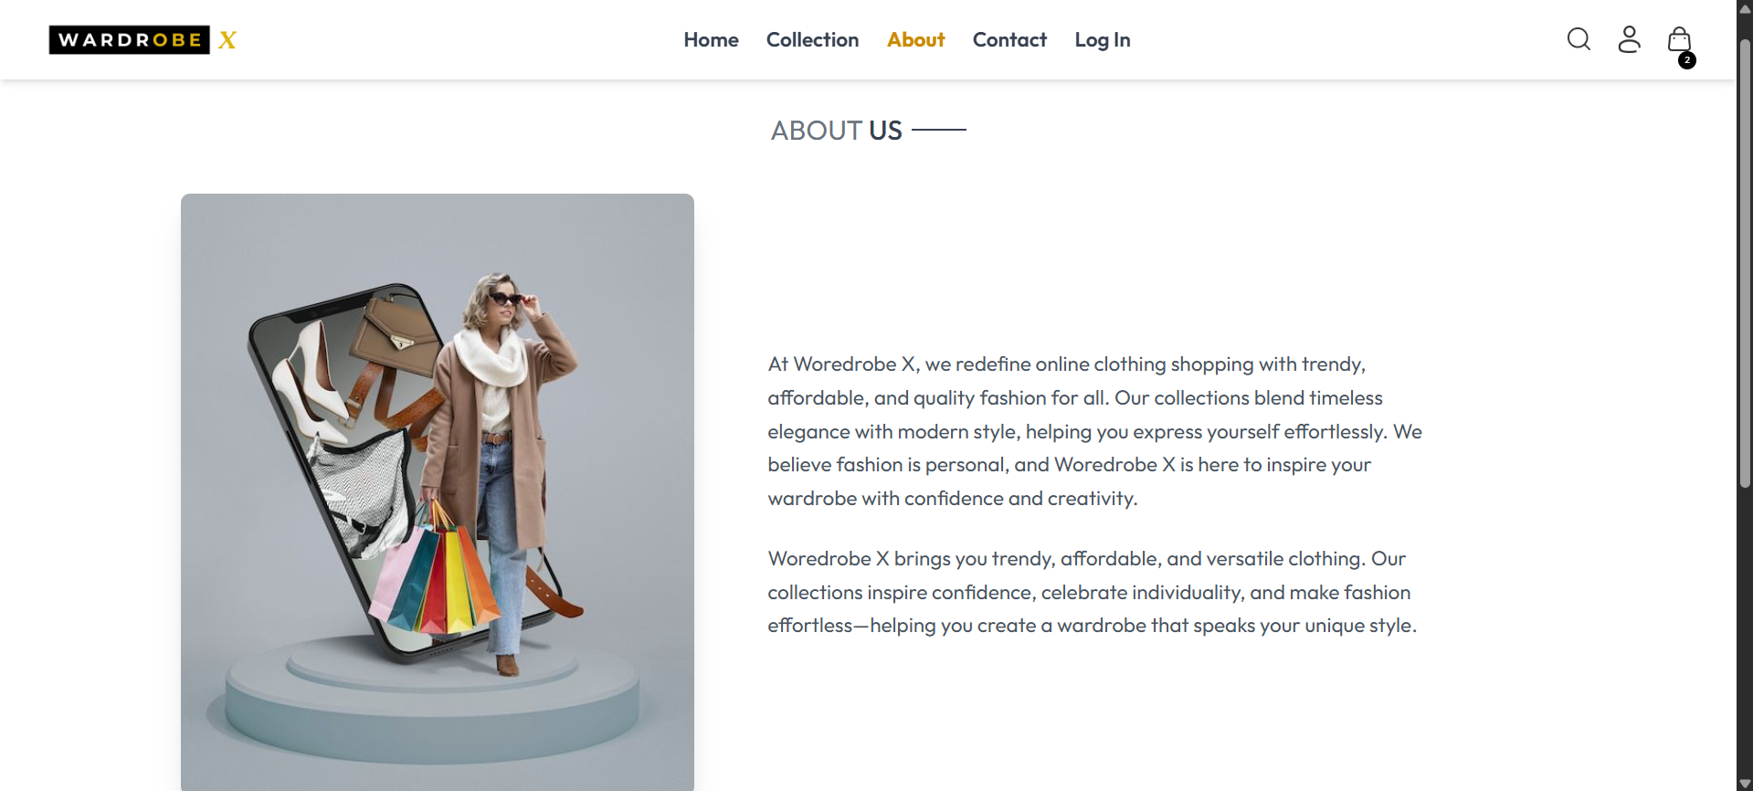
About Page :

Slide 26
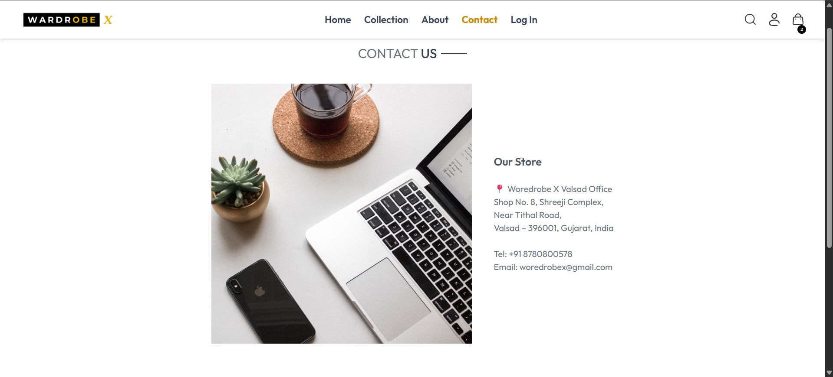
Contact Page :

Slide 27
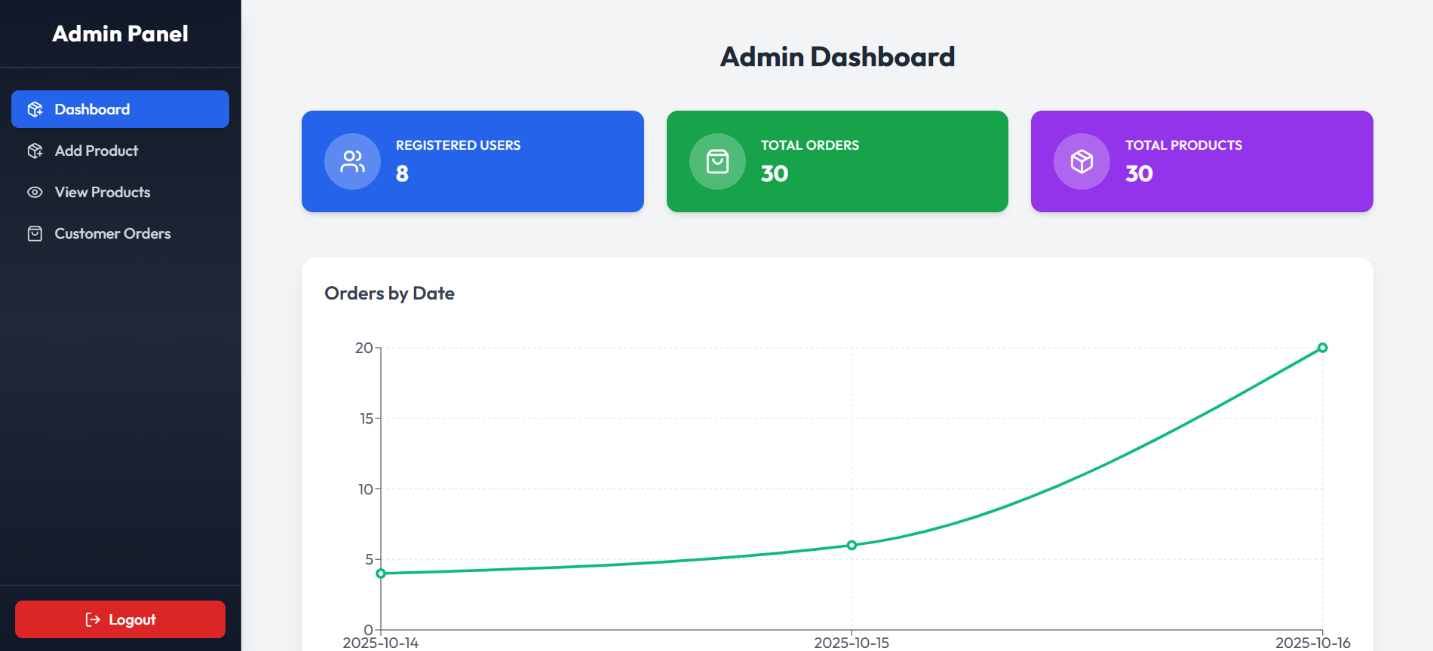
Admin dashboard :

Slide 28
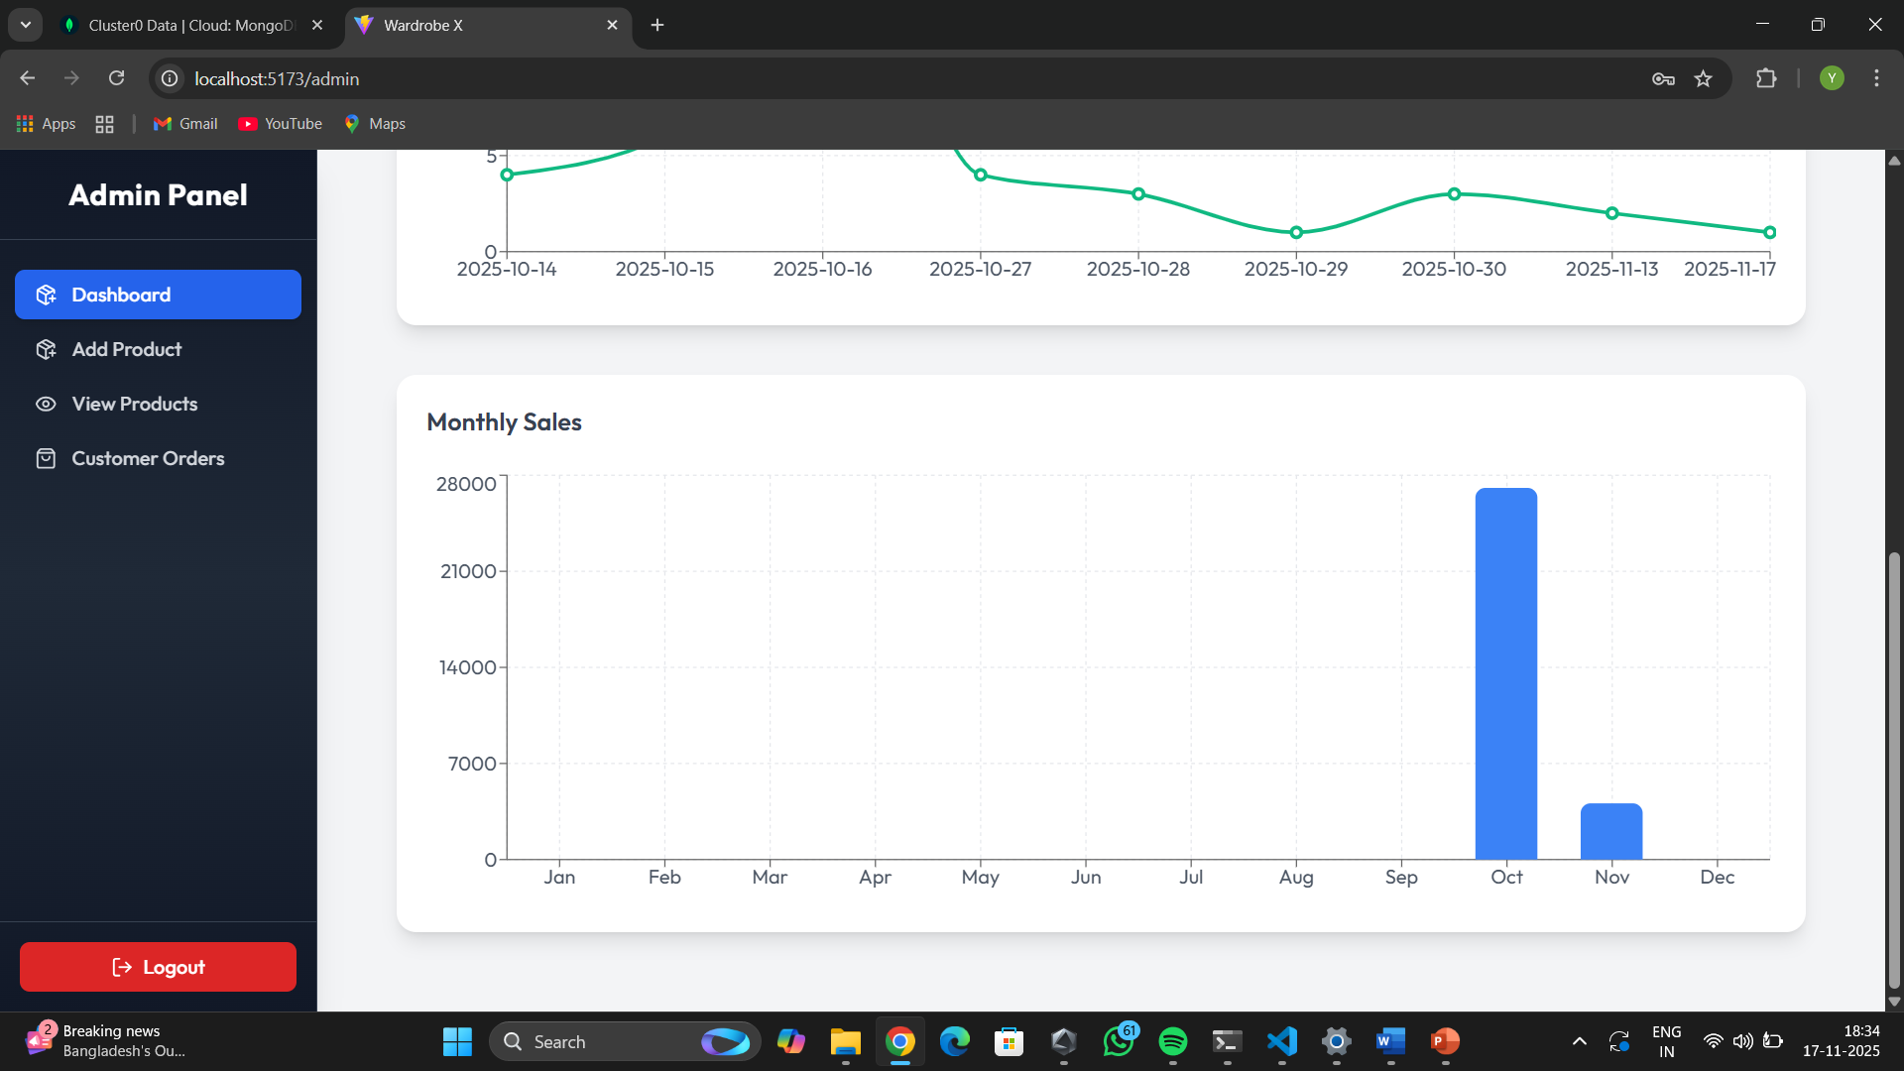
Admin Dashboard :

Slide 29
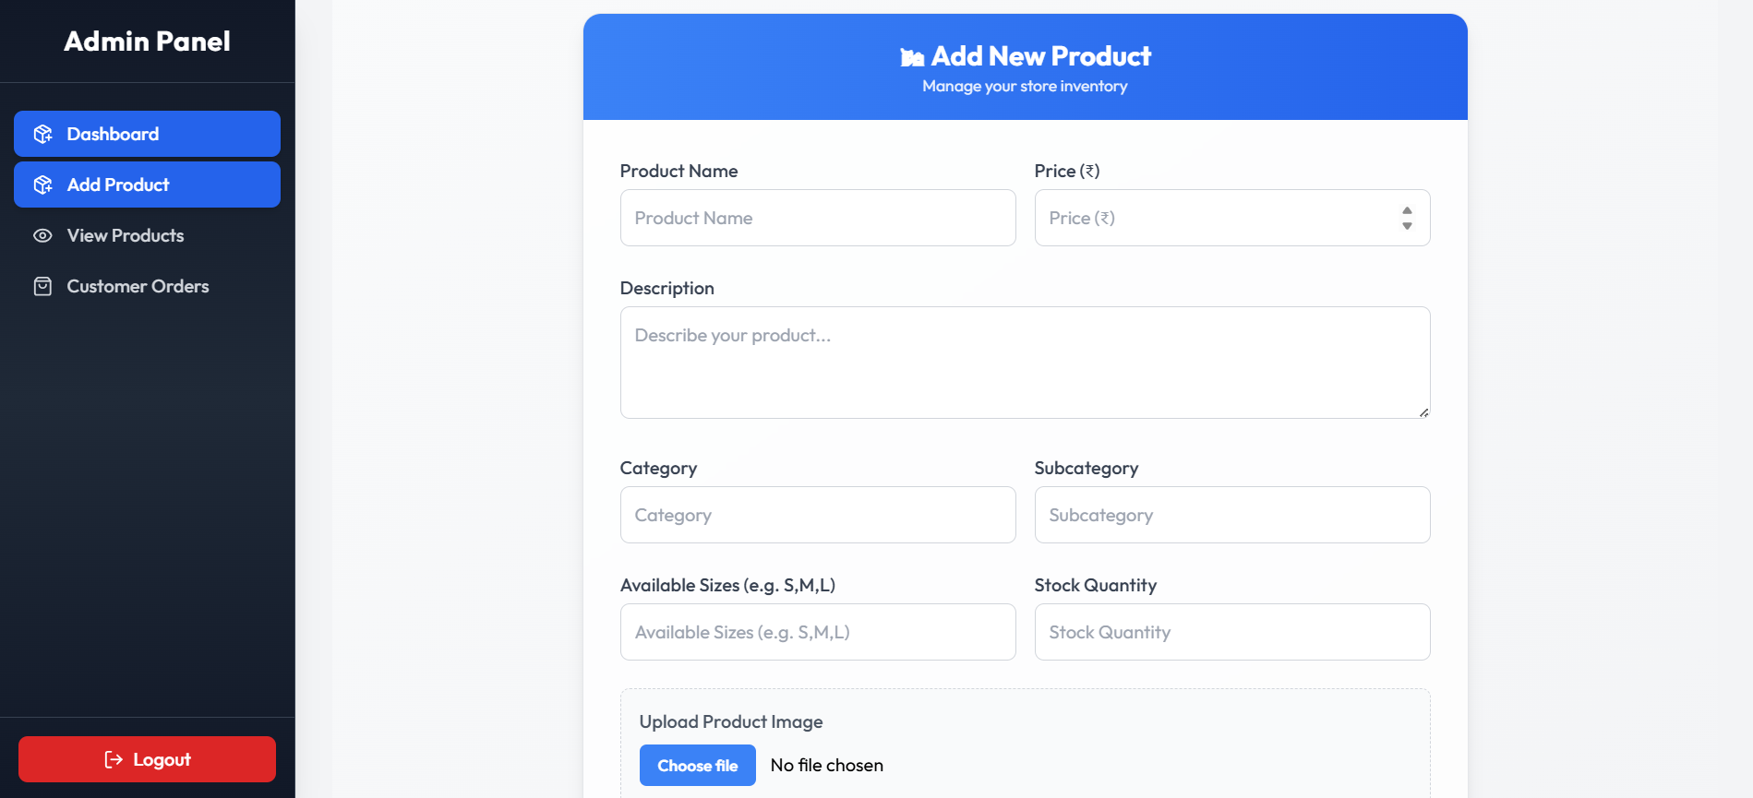
Add Product :

Slide 30
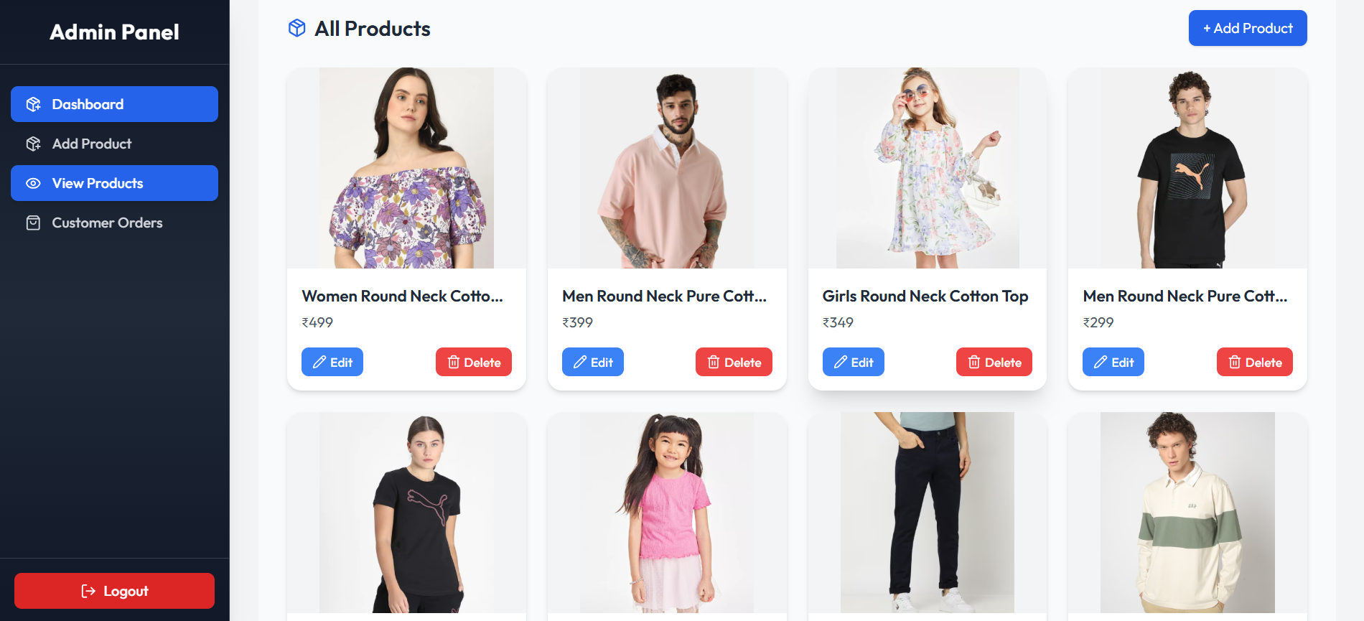
View Product :

Slide 31
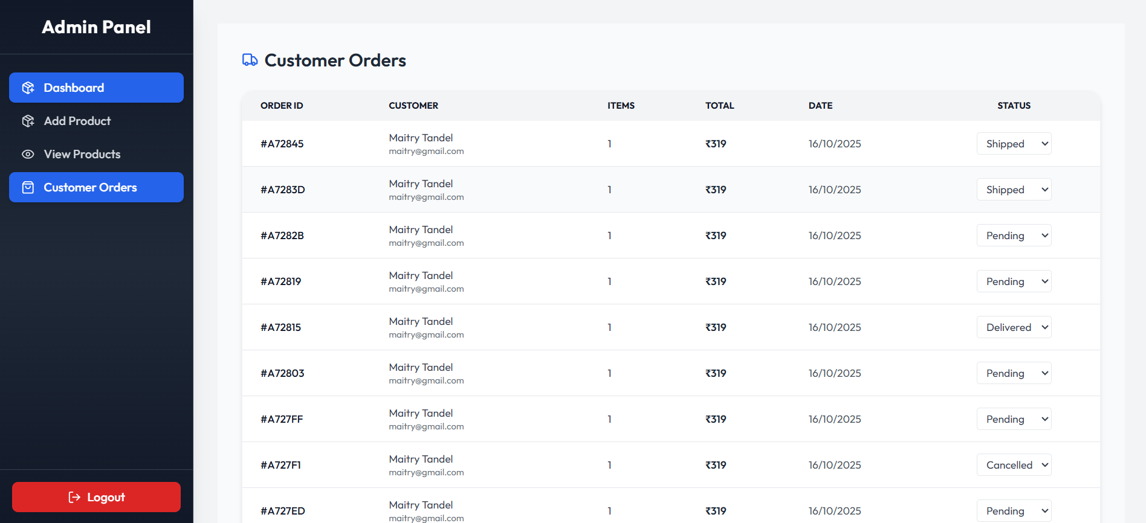
Customer Orders :

Slide 32

THANK YOU

